Slide 1
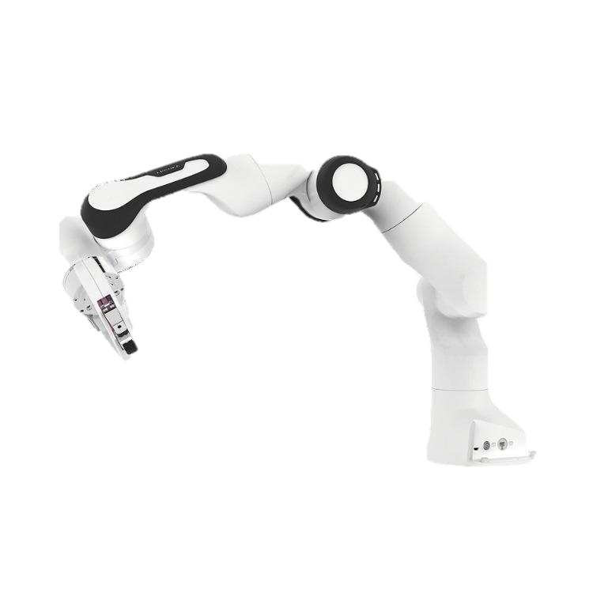

Final Project
Team_9 Zhanqian Wu, Jie Mei, Enlin Gu, Jiani Wang
University of Pennsylvania

Slide 2
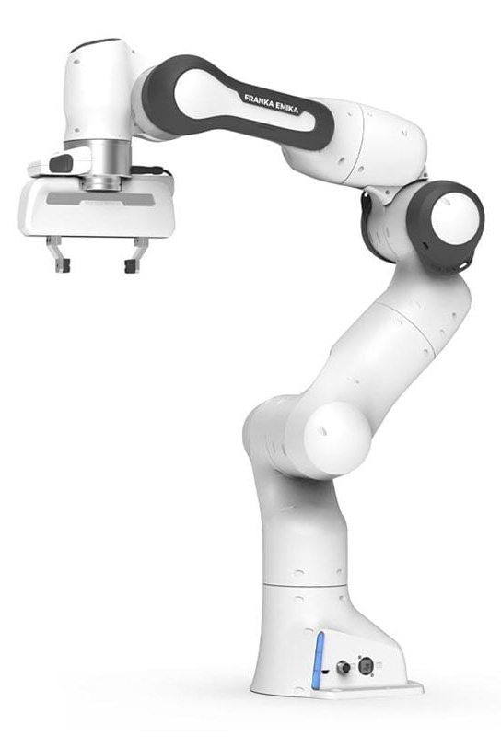
Contents
01) Test & Evaluation Plan
02) Coordinate transformation
03) 2D Collision Detection
04) Sequencing Algorithm & Gripper orientation
05) Path Planning
06) Dynamic Block Preliminary Outline
Plan
Methodology
Results & Discussion

Slide 3

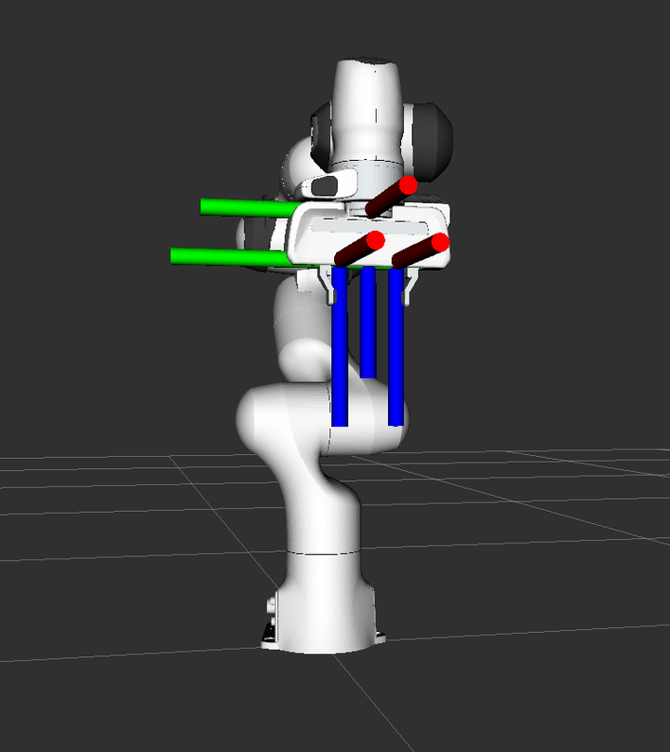
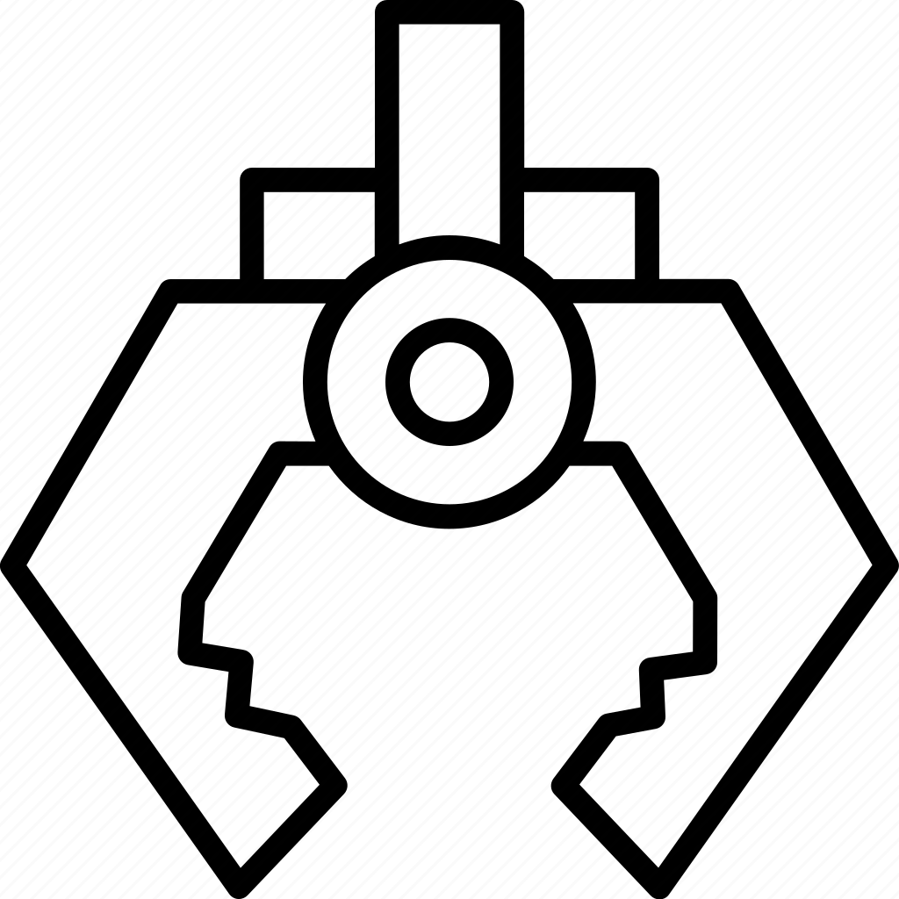


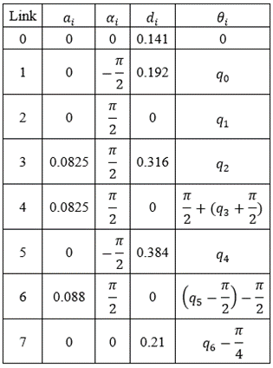
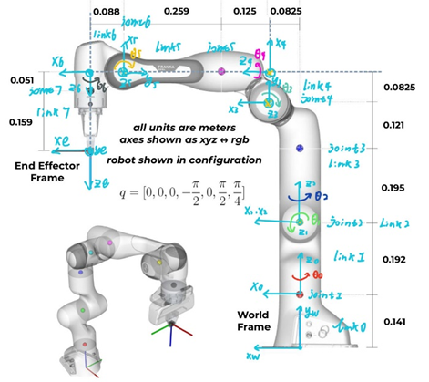
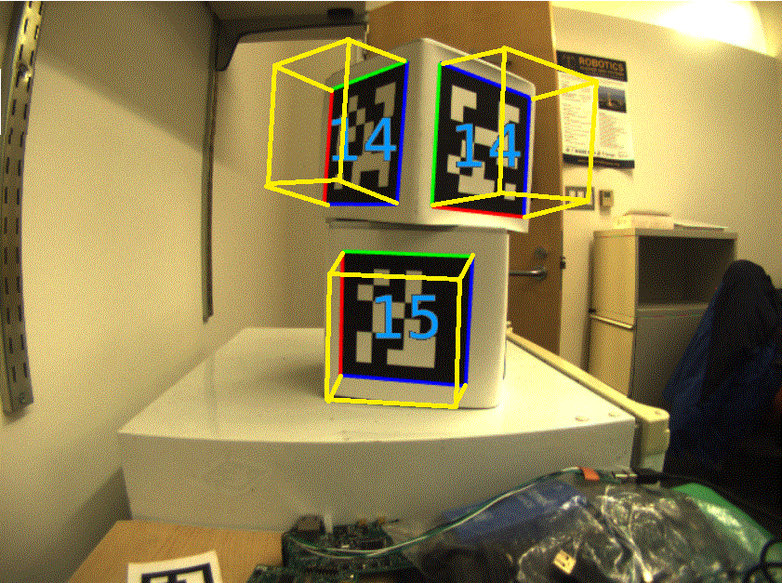
Coordinate transformation
Camera frame to End-effector frame transformation
Camera Frame
get_H_ee_camera(self)
End effector Frame
② End-effector frame to world frame transformation
World Frame
Where a homogeneous transformation matrix from frame i to i-1 is:
D-H
③ AprilTag Detection
AprilTag is a type of fiducial marker system used in computer vision and robotics for pose estimation and object tracking.

Slide 4
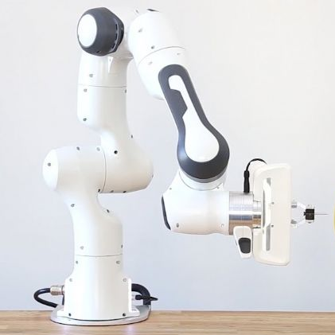
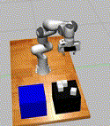
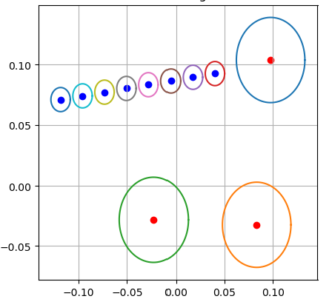
2D Collision Detection
collision
collision
No collisions
Real-time Navigation Map Structure:
Real-time Navigation Map
{Cube 1~n: [x,y,Radius, Orentation], Gripper: [x,y, Orentation]}
Gripper
Collision Detection → Intersecting circles Detection
Cubes
for center1 in obstacle_map:
for center2 in gripper:
distance = sqrt((center1[0] - center2[0]) ** 2 + (center1[1] - center2[1]) ** 2) radius_sum = radius1 + radius2
if distance <= radius_sum:
count +=1

Slide 5
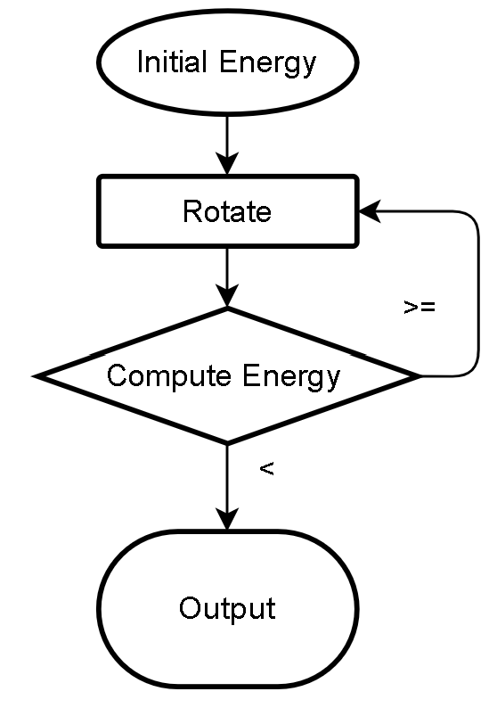
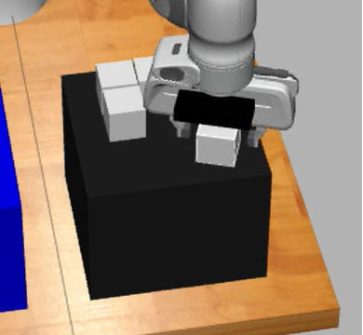
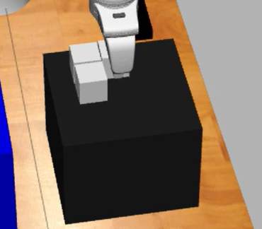
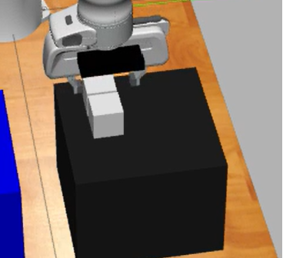
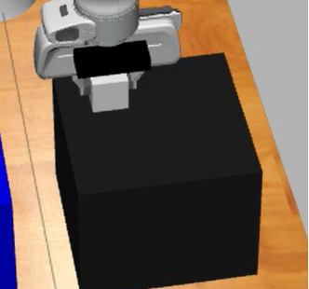
Sequencing Algorithm & Gripper orientation
Grabbing cube
u=1
2
√
×
√
×
1
3
×
×
×
√
4
Move to the end
of the queue
Without sequencing：
{1-2-3-4}→Fail
√
×
×
×
√
×
With sequencing：
{4-2-3-1}→Success
×
×
√
√
Where:
u=1 if collision free
u=-1 if collision
With the sorting algorithm, we were able to achieve a more efficient task.

Slide 6
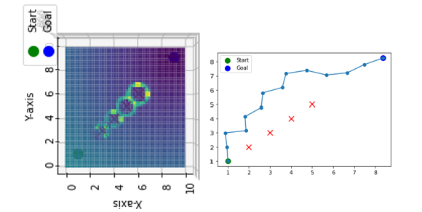
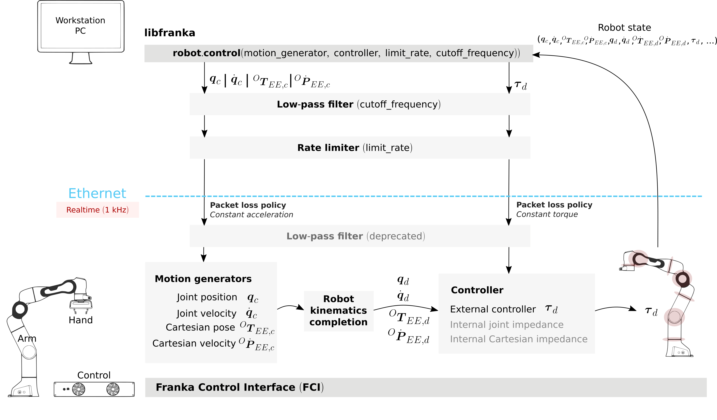
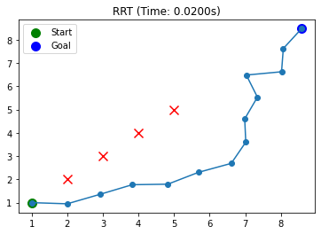
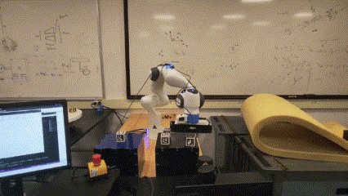
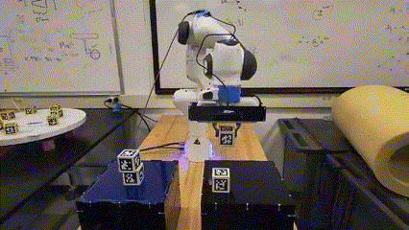
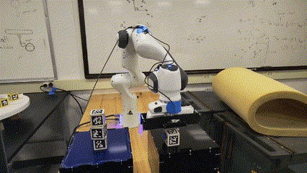
Path Planning
APF
Our Strategy
RRT
Uncontrolled Path
Path Planning
Controlled Path
RRT or APF Path
Path Control Point
Control
Point
linear interpolation
Prior Knowledge:
The longer the path, the longer the planning time
Most collisions occur during the grab and drop process
10 Random Tests:
 | Average Planning Time | Average Execution Time | Total Time
APF | 5.17↑ | 9.32↓ | 14.49
RRT | 6.48↑ | 10.61 | 17.09↑
Our’s | 0.89↓ | 10.87↑ | 11.76↓
We only need path planning for the initial and final stage to save computation time
With this path planning strategy, we were able to achieve a more efficient task.
Test Environment: CPU:I9-13900H, RAM 32G, Ubuntu 18.04

Slide 7
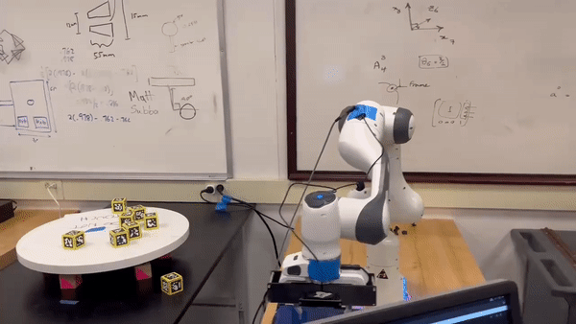
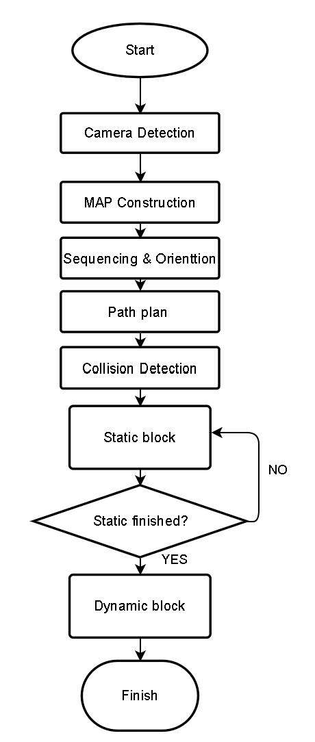
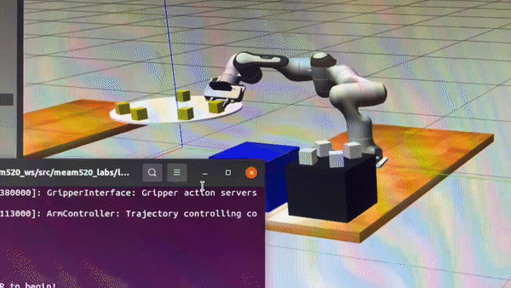
Dynamic Tasks Video Demo & Architecture
Detection
Plan
Initial Grabbing Pose
Control
Reviewed Grabbing Pose
Overall Planning and Control Architecture

Slide 8
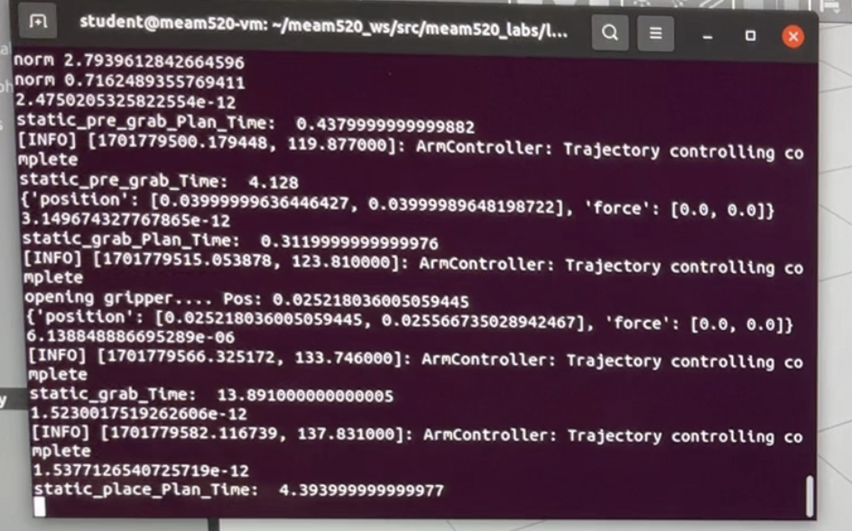
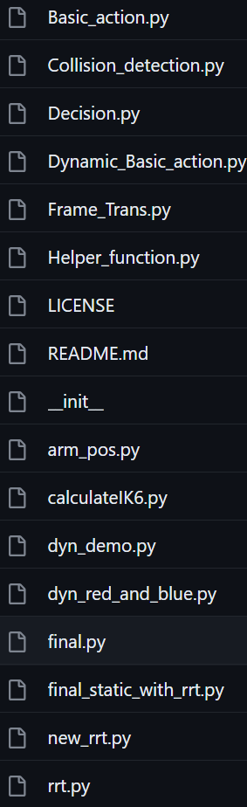
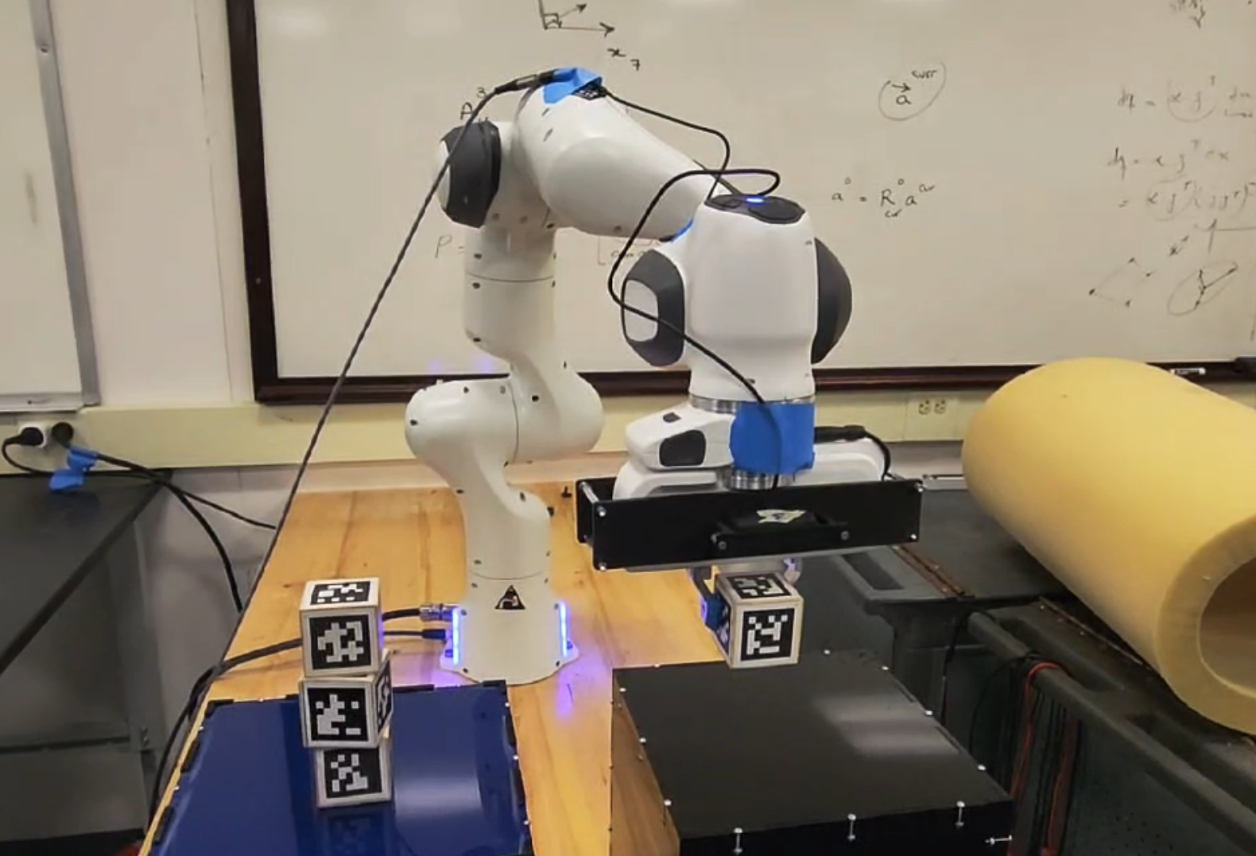
Test & Evaluation Plan
Simulation Testing Plan
Code
Print how much time is used for each task
Print matrix & joint angle to check state
Report issues when occur
Divide task into Red, Blue, Static and Dynamic block catching
Write grab / place and other basic actions into functions
Check each function separately
Dynamic Block test
Subsystem test
Static Block test
Integrated Test
Real Lab testing Plan
Code test
Error & Warning?
Check if our points are correct & adjust
Check if our code work for different block pose
Function test
Working properly?
Metrics:
Average time (s), success rate (%)

Slide 9
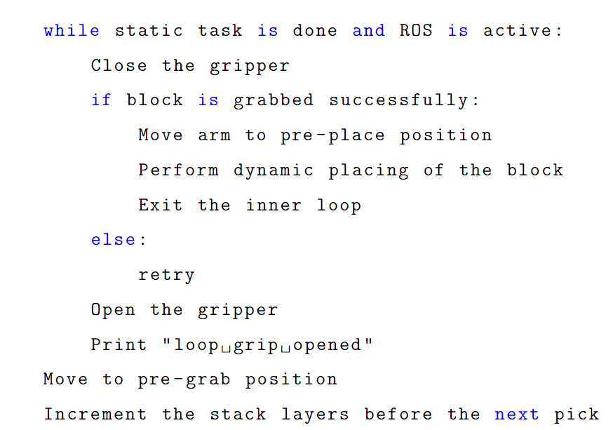
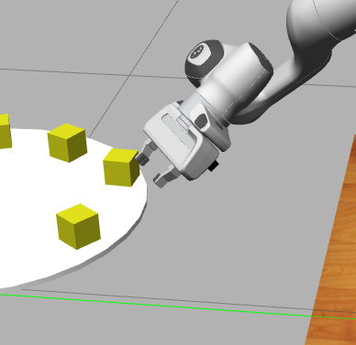
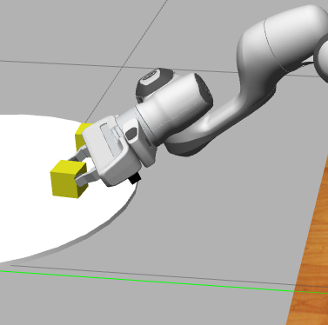
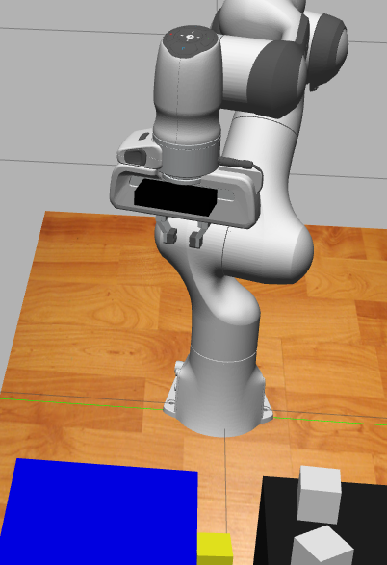
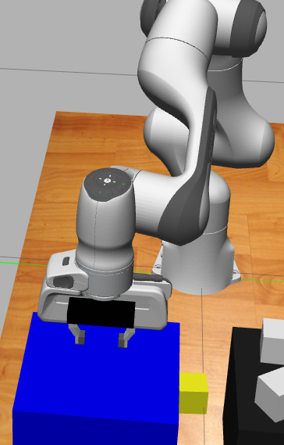
Dynamic Block Preliminary Outline ( Test Plan)
Ideal Approach:
Detect the blocks.
Solve the blocks' poses in robot's world frame.
Make a prediction on the moving blocks placed on the turntable.
Move the arm to the predicted grabbing position.
Pick and place the blocks.
Actual Implementation
Set up and calculate pre-grab and grab position.
Solve for the corresponding poses using IK.
Move to the pre-grab then to the grab position.
Once the grab position is reached, continuously open/close the grip until a block is grabbed successfully.
Move to a safe pre-place position that won't influence the stack with collision detection.
Pre-grab pose
Grab pose
Pre-place pose
Place pose

Slide 10
Dynamic Block Preliminary Tests
Performance Metrics:
Position of the four pre-define grab and place positions. Mismatches needs to be considered in the physical testing.
Time Needed to complete each cycle of picking and placing the dynamic block.
Rate of success in grabbing the real setting (limited environment in the simulator).
Red VS Blue discrepancy.
Next Steps:
Find efficient seeds for solving IK.
Maximize the successful rate by choosing and testing different positions.
Integrate with the static tasks.
...
 | Poses Mismatch (m) | Time before grab (s) | Grabbing Time (s) | Placing Time (s) | Success Rate
Avg. | +- 0.18 | 4.82 | TBD | 9.14 | TBD

Slide 11
Thank you for your time!
Team 9

